Slide 1

The Well-Be Project and the impact of Covid-19 on secondary student mental health
Presentation by Dr. Nick Owen MBE
CEO, The Mighty Creatives

Slide 2

Introduction
Welcomes
Introduction to The Mighty Creatives
Introduction to The ‘Well-Be’ Project
Project Aims, Objectives and Outputs
Intellectual Output 1: Survey Research Handbook studying the impact of crisis stress on the mental health of secondary school students
Intellectual Output 2: Well-Be Teachers Guide
Good Practice Guides
Notes:
Remind them of our focus

Slide 3

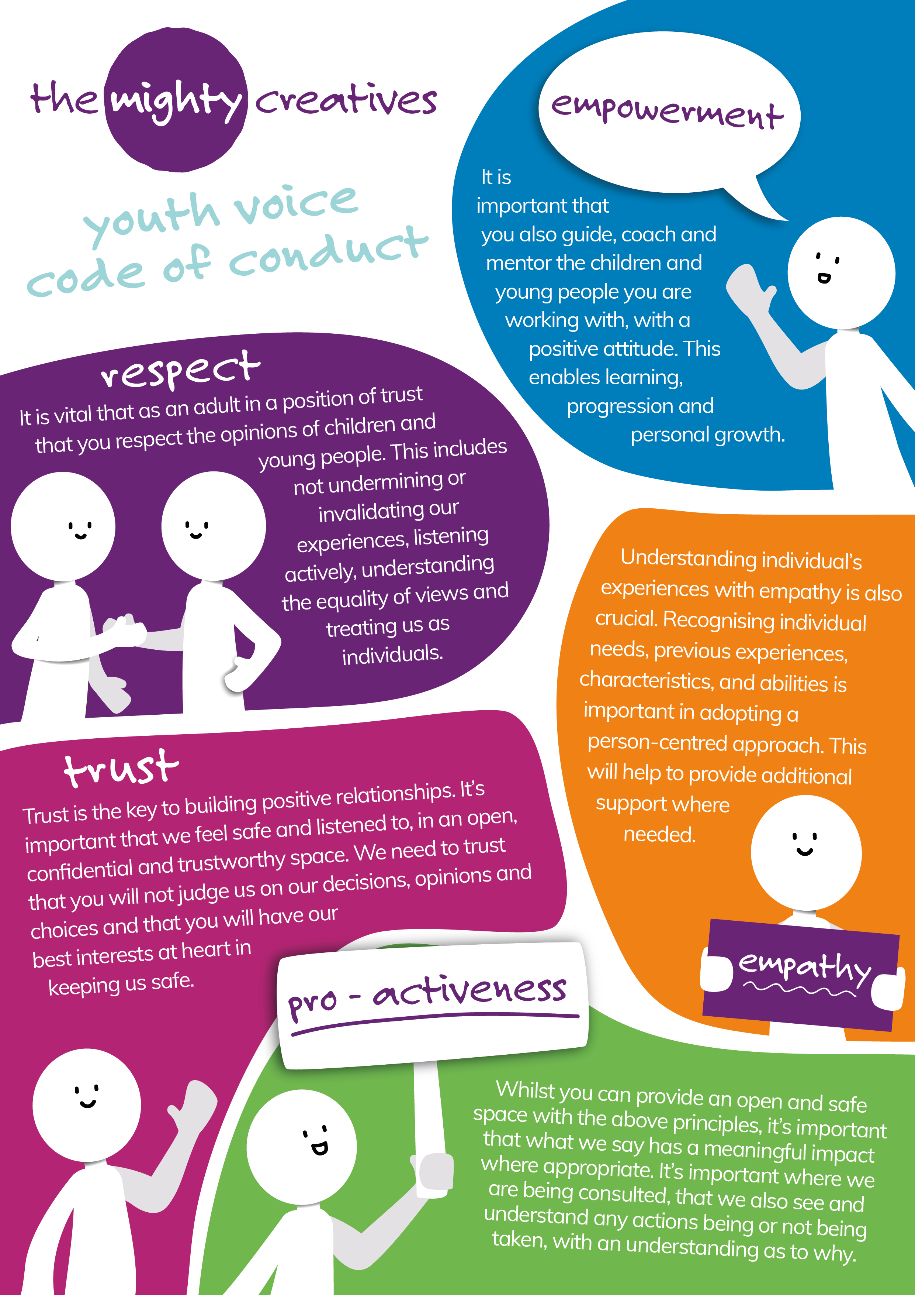

We are The Mighty Creatives
Company limited by guarantee and a registered charity
Based in Leicester and serving the whole of the East Midlands since 2009
Growing national and international reach
Turnover of approx. £4.1m in 2021/22
Funded by Arts Council England as ‘Bridge Organisation’ since 2012: others include Children in Need, DWP, Charities Aid Foundation

Slide 4



Our Vision
I remember an inspirational teacher at Primary School who I think changed the trajectory of my life. He incorporated art into history projects, science, and literature. He also read amazing, quite advanced books to us and I just remember it opening a whole new world to me.
(Alexa, Leicester)
Inspiring children and young people to harness the power of arts, creativity and culture for positive change
Engagement through a person-centred pedagogy e.g. mentoring and coaching
Creative voices of young people at the heart of the creative or cultural experience

Slide 5
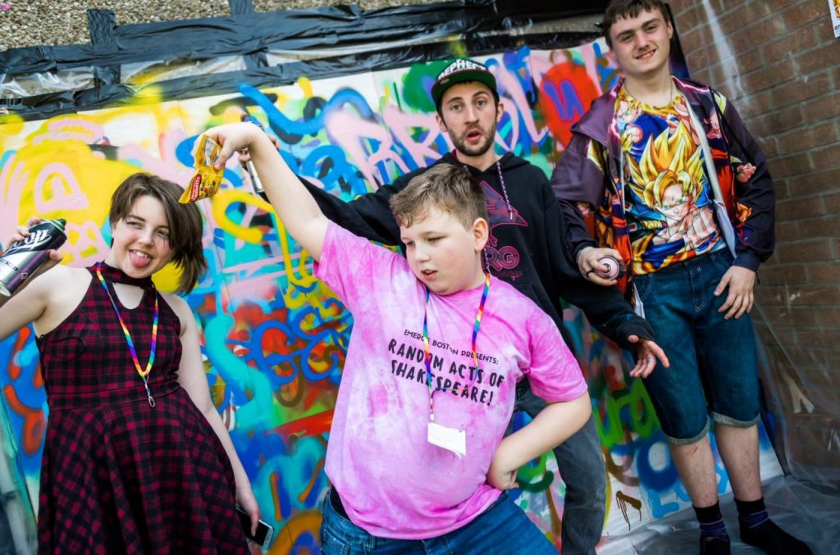
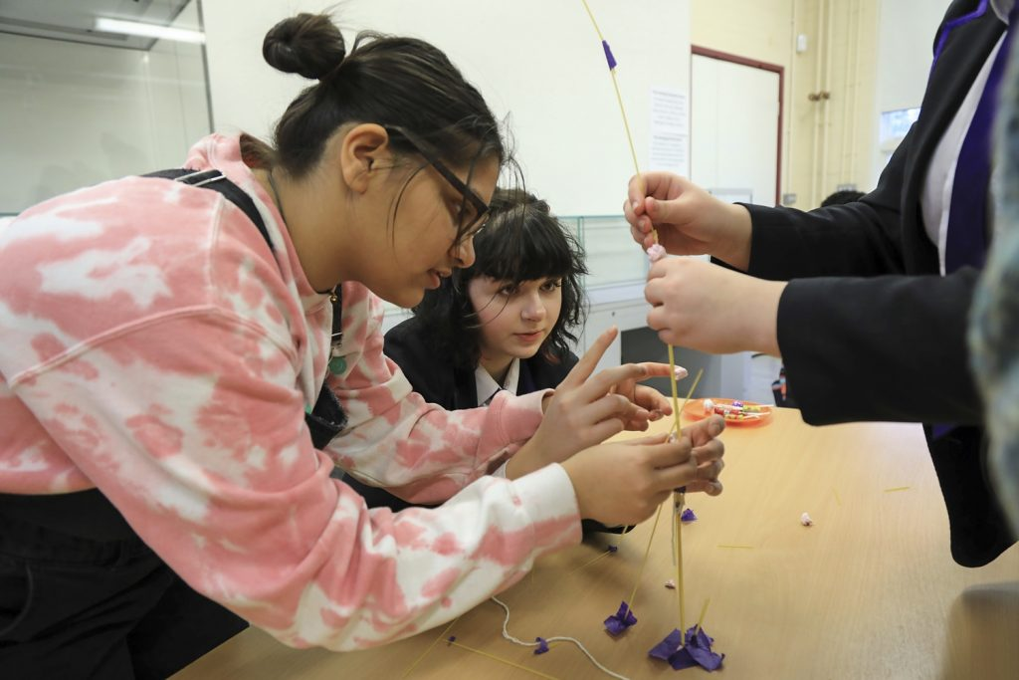
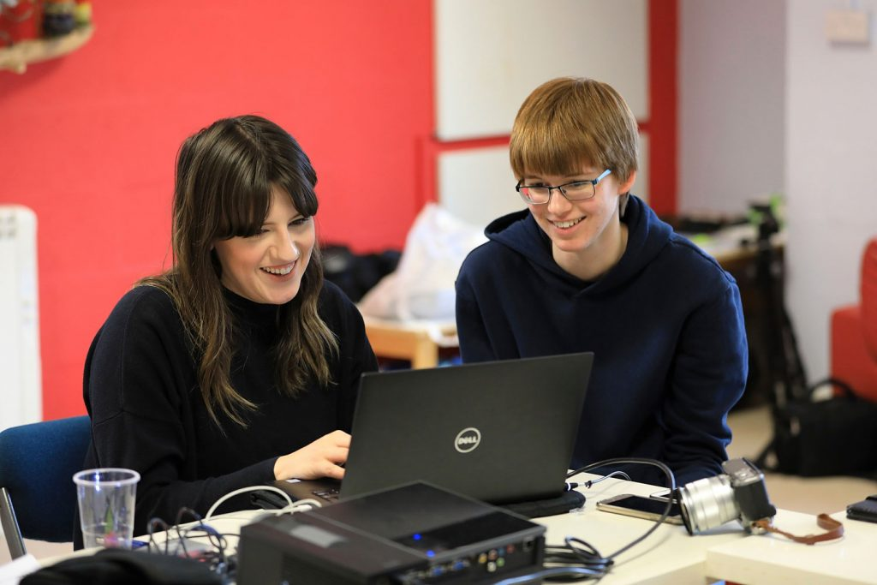
Our Mission: how we achieve our vision
1. Co-design, develop and deliver high quality creative activities in order to increase their participation and skills (Creative Schools)
2. Strategic partnerships which strengthen access and progression opportunities (Creative Communities)
3. Cultural practice which supports young people in need (Creative Mentoring)
4. Employment and enterprise progression routes into the cultural and creative industries (Creative Futures)
5. Creative expertise for the cultural education sector workforce (all programmes)
Notes:
Again, another reminder of who we are and what we are fighting for.
Our vision is a world where all C&YP can harness the power of arts, creativity and culture in order to transform themselves, their communities and their futures.
We fight for the creative voice of children and young people from birth to 30, particularly for the most excluded children and young people, in order to transform their:
personal and social wellbeing
skills development
educational achievement
cultural engagement and
economic prospects.

Slide 6
Creative Schools
Objectives | Typical Activity
* To support young people to design, develop and deliver high quality creative activities in order to increase their participation and skills * To develop and promote creativity expertise for the cultural education sector workforce | Artsmark Action research / CPD for artists and teachers including commissioning programmes SEND focus / EY focus Well-Be research project into mental health of young people (Erasmus+ project)

Slide 7
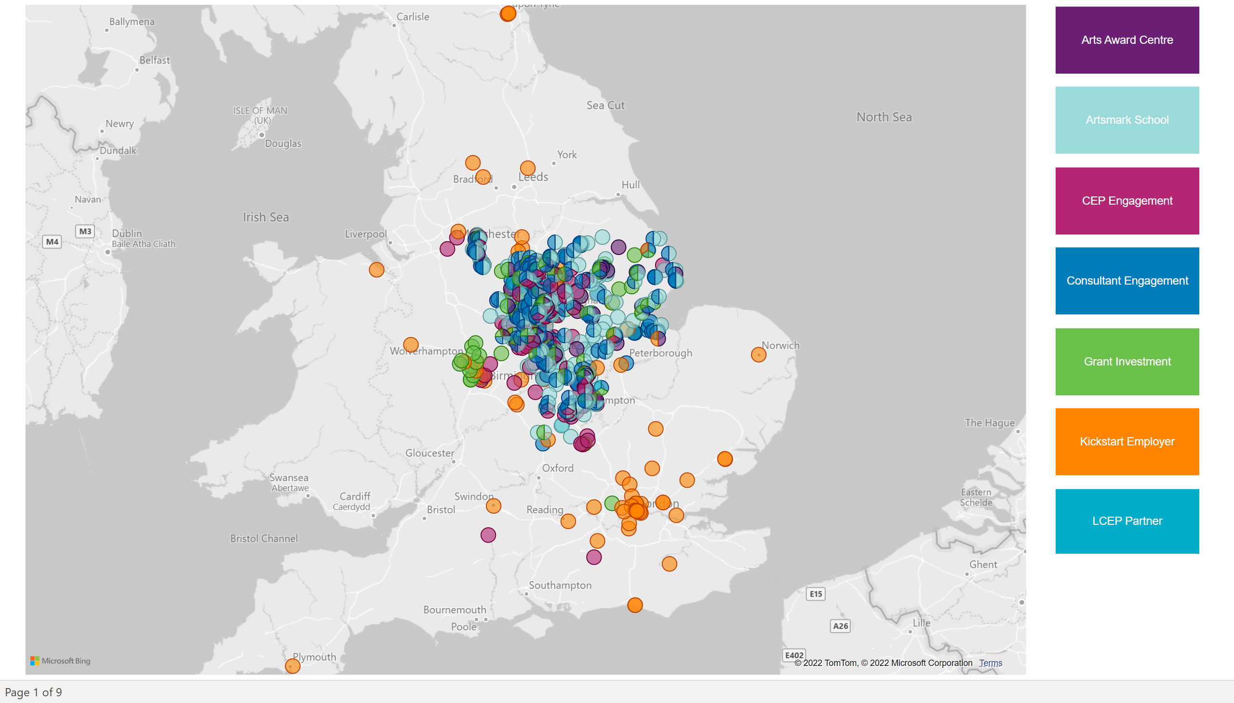
Our impact: where we’ve been working…

Slide 8

Critical times for our young people
The Challenges:
Reduction of arts provision in schools and colleges
Lack of arts and culture in some parts of the region
1 in 7 young people aged between 5 and 16 experience one episode of need across the UK: with 30% more young people in care in 2020 than there were in 2015.
Covid-19’s long term challenges to young people’s mental health, well being, social connectivity, educational and economic prospects.
2022: Ukraine, Cost of Living, Energy Crisis…+++
Notes:
Remind them of our focus
As reported by the End Child Poverty Action Group, there were 4.3 Million children living below the poverty line in the UK in 2019-20. According to the latest report from Resolution Foundation ‘The Living Standards Outlook 2021’ Rising unemployment and the removal of the £20 uplift in 2021-22 will lead to a further 1.2 million people falling into relative poverty, 400,000 of whom will be children, the biggest year-on-year rise in poverty rates since the 1980s.
https://cpag.org.uk/child-poverty/child-poverty-facts-and-figures
https://www.resolutionfoundation.org/app/uploads/2021/01/Living-standards-outlook-2021.pdf
By 2024-25, they project that 23.0 per cent of individuals will be living in relative poverty. Relative child poverty will also rise, with the roll-out of the two-child limit and removal of the family element for families on benefits pushing over one-in-three (33.7 per cent) of children into poverty by the end of the parliament, 730,000 more than in 2020-21.

Slide 9
Introduction to Well-Be
The Why, Who and What of Well-Be
Notes:
Remind them of our focus

Slide 10
Why we started Well-Be in April 2020
Isolation
How to cope and how to live in the “new normal”?
Crisis
COVID - 19
Pandemic
Stress

Slide 11
The Well-Be Partnership
The Mighty Creatives
United Kingdom
M&M Profuture Training, S.L.
Spain
Fo.Ri.Um. società cooperative
Italy
National Management School
Bulgaria

Slide 12

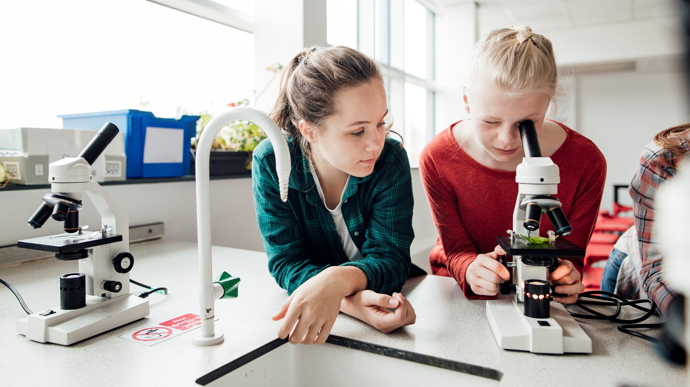
Well-Be
Supporting Students Emotional Health, Well-being and Resilience in Times of
Global Crisis
The Well-Be Proposal
Duration: 24 months
01/11/2020 – 31/12/2022
Ref.N 2020-1-UK01-KA201-079148

Slide 13
Well-Be Partners Responsibilities
Р1
Overall project management, maintaining effective communication within the consortium and with the National Agency.
Р3
IO2 (Teacher's Guide) elaboration and making all materials published online in a substantial quality and design
Р4
Dissemination, incl. project website, logo, materials, coordination of information activities
Р2
IO1 / Survey Handbook/: the survey tools and guide and Comprehensive Analytical Report preparation

Slide 14
The Well-Be Project Aims
To support upper-level secondary education students in building resilience resources and overcoming
the negative effects of social exclusion
after the end of the epidemic.
To update educational priorities on the psycho-emotional status of the students and to support teachers in their social role in the “new reality”

Slide 15
Identifying students' current status with regard to theirs: - emotional state/effects of stress - motivation for learning and development - support and training needs 2 Developing Guidelines for working with students to build resilience and overcome the negative consequences of stress and boost their motivation for learning and development
The Well-Be Project Objectives
1. Identifying students' current status with regard to their
  emotional state/effects of stress
  motivation for learning and development
  support and training needs
2. Developing Guidelines for working with students to build resilience and overcome the negative consequences of stress and boost their motivation for learning and development

Slide 16

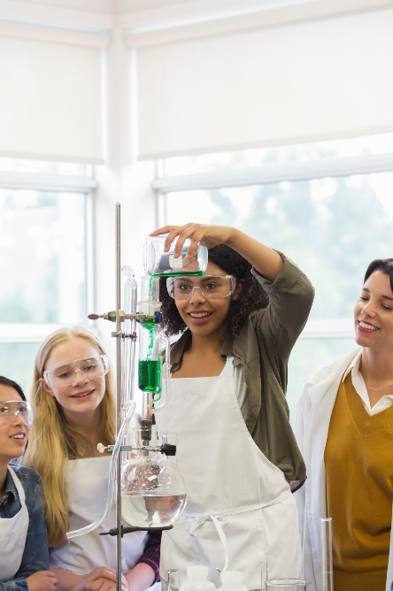


The Well-Be Beneficiaries
Students
from secondary education level
(14-19 years)
Their
Teachers, pedagogical advisors and school psychologists
Direct
Indirect

Slide 17


The Well-Be Project Outputs
IO1: Survey Research Handbook
contains evaluation tools for teachers, students and parents, which measure students` psychological state of being
Teacher`s Guide –
online repository of How-To’s to keep positive climate at school

Slide 18
The Well-Be Innovation model
A synchronized comprehensive survey
Students
Their parents
Their teachers
Assumptions and hypotheses
Objective picture for students needs
Appropriate trainings and activities

Slide 19
The Well-Be Intellectual Output 1 (IO1)
A Survey Research Handbook studying the impact of crisis stress on the mental health of secondary school students
Notes:
Remind them of our focus

Slide 20
Analysis of the pandemic in the partner countries
November – December 2021
A high similarity in the dynamics of the pandemic and the nature of the counter-epidemic measures that were adopted.
In Bulgaria the lockdowns were shorter and less widespread than in the UK, Spain and Italy, also lower vaccination coverage in the population
Distance education introduced for large numbers of students for varying lengths of time, forcing children into isolation and putting them in greater inequality.
Health experts warned that this would result in increased risks to their mental health and development. In particular, distance learning negatively affects their stress levels and emotional state, the quality of their education, and their communication skills.
Overcoming the crisis required a series of measures beyond the restoration of face-to-face learning.

Slide 21
Aims of the Survey Research Handbook (IO1)
To create an implement a reliable instrument to study the impact of the pandemic on the current mental state of secondary school students:
a complex methodology for studying the dynamics of the researched phenomena which provides a basis for comparative analyses and forecasts for the development of the processes in a European perspective.
developed in the context of stress and resilience theory, mental well-being and motivational dispositions.
Statistical procedures:
  Descriptive statistics
  Factor analyses
  ANOVA analyses/T-tests (Group Comparisons)
  Correlation analyses
  Demographic analyses

Slide 22
The impact of the pandemic on students
About 50% students and parents rated the impact of the pandemic on young people as very negative or negative.
This is also shared by teachers, who believe that the negative effects of the pandemic are manifested in a decline in motivation to learn, activity in the learning process, coping with learning materials and academic performance, communication and self-expression skills, sense of well-being, and mood fluctuations.
25% participants rated children's mental health as impaired.
The most pronounced symptoms of stress, are in the emotional and intellectual spheres.
Respondents observed tension, distraction, laziness and reluctance to act, irritation, learning problems, and fatigue.
Respondents from the UK and Spain also reported physiological symptoms related to sleep and appetite disturbances.

Slide 23
Sources of Stress
According to young people, the most serious sources of stress are:
loss of living contacts with people and meetings with friends,
entertainments and favourite food and drinks from restaurants outside,
a clear vision of the future and freedom of action.
According to teachers, sources of stress for students during the pandemic period in mostly in an e-learning environment are as follows:
monotony,
social isolation,
lack of physical activity,
maintaining continuous/permanent concentration,
the need for self-organisation and self-discipline,
need for additional support for learning.

Slide 24
Sources of Stress
All participants agree that the restrictions imposed by the pandemic which affected students entirely negatively or rather negatively were:
limitations on meeting friends,
limited live contacts,
limitations on sports activities,
lack of freedom of action,
not going to school.
According to all respondents, the following lifestyle changes have had a negative impact on children:
time spent in front of a computer,
pressure from prohibitions,
physical distancing,
wearing masks,
home isolation,
limited personal space at home,
fears and insecurities of adults,
constant presence of parents.

Slide 25
Overall impact of the pandemic
Overall Influence of the pandemic (N=846)
Bulgarian students evaluate the overall influence of the pandemic more positively than do students from Spain and the UK.
Italian students evaluate this influence more positively than UK students.
Country | Mean | SD
Bulgaria | 2,67 | 0,773
Spain | 2,46 | 0,721
UK | 2,39 | 0,692
Italy | 2,61 | 0,810

Slide 26
Impact on physical health
Students from Spain rate their physical health most positively in comparison to the rest of the students. They are followed by Bulgarian students, then Italian students.
Students from UK give the lowest evaluation of their physical health.
Country | Mean | SD
Bulgaria | 3,82 | 1,108
Spain | 4,16 | 0,741
UK | 2,88 | 1,052
Italy | 3,52 | 1,002

Slide 27
Impact on mental health
No significant difference is found only between Italian and Bulgarian students – their evaluation of their mental health is equal; it is also higher than UK students’ evaluation and lower than the evaluation Spanish students give of their mental health.
Country | Mean | SD
Bulgaria | 2,98 | 1,290
Spain | 3,96 | 0,929
UK | 1,64 | 0,826
Italy | 2,95 | 1,192

Slide 28
Impact on stress symptoms
Bulgarian and Italian students report experiencing the same amount of stress symptoms during the pandemic.
Spanish students experience less stress symptoms than all other students
UK students experience more stress symptoms than the other three samples
Country | Mean | SD
Bulgaria | 57,39 | 16,189
Spain | 47,86 | 15,849
UK | 66,87 | 13,908
Italy | 58,51 | 14,002

Slide 29
The effects of the restrictions
Bulgarian and Italian students evaluate the effect of restrictions more positively than do students from Spain and the UK.
Spanish students also evaluate these effects more negatively than students from the UK
Country | Mean | SD
Bulgaria | 21,40 | 7,313
Spain | 15,08 | 3,890
UK | 18,98 | 3,849
Italy | 20,24 | 7,078

Slide 30
The impact on the relationship with adults
Students in Italy and Spain evaluate the effects of their relationships with adults more positively than do students from Bulgaria and the UK.
Country | Mean | SD
Bulgaria | 6,99 | 2,160
Spain | 7,37 | 1,854
UK | 6,54 | 1,753
Italy | 7,88 | 2,400

Slide 31
Effects on external help
Students from Spain report that external help has been less helpful for them in comparison to students from Bulgaria and the UK
Country | Mean | SD
Bulgaria | 2,44 | 1,865
Spain | 1,09 | 2,055
UK | 2,75 | 2,195

Slide 32
The effects on personality potential
Spanish students report having the most personality potentials in comparison to other countries, while UK students report the least.
Bulgarian and Italian students score equally on this scale, placing them in the middle of all countries.
Country | Mean | SD
Bulgaria | 50,61 | 11,894
Spain | 53,77 | 12,421
UK | 41,12 | 9,322
Italy | 48,47 | 10,344

Slide 33
The effects on subjective wellbeing
Students from the UK report the lowest levels of subjective wellbeing, followed by somewhat higher scores among Italian students.
Bulgarian and Spanish students have equal scores
Country | Mean | SD
Bulgaria | 17,29 | 5,644
Spain | 18,08 | 4,510
UK | 13,10 | 4,806
Italy | 15,89 | 5,652

Slide 34
The impact on vulnerable groups
The comparative analysis shows complete consistency across all partners:
Girls report more symptoms of stress, poorer physical and mental health, lower sense of subjective well-being and use more passive coping strategies than boys
Older students (18-19 years old), have a more negative assessment of the impact of the imposed restrictions, changes in lifestyle and the pressure of external coercion compared to younger ones
Children living with one parent or without parents experience more symptoms of stress.
Children with siblings who share a stronger negative effect of the pandemic than adolescents who are the only children in the family.
Based on all the data and analyses, we concluded that support measures should integrate training, communication and administrative activities

Slide 35
Guidelines on student support measures: training
For students
Training measures focusing on the development of:
Self-knowledge in order to stimulate confidence in children's personal potential.
Critical thinking, social engagement and self-discipline in adolescents in order to build a more active personal and civic position.
Stress resilience - presenting the benefits of active, problem-solving and meaning-related coping strategies and relaxation techniques to encourage the application of a wider range of stress management strategies.
Internal adaptation resources with priority on goal-setting skills, planning and organizing, positivity and flexibility, techniques to maintain concentration to increase confidence in them and their application.
Communication skills to improve interactions both with each other and with older adults - parents and teachers; giving and receiving social support.
Self-regulated learning skills in order to maintain motivation to learn and to cope autonomously with learning tasks.

Slide 36
Guidelines on student support measures
For Parents:
Training measures include focusing on the development of:
Improving parents' skills for meaningful communication with children in isolation and for improving the home climate (school for parents or other socially engaging activities, training materials).
Encouraging open communication between students and parents, as well as teachers and parents, so as to attract attention to experience of stress and anxiety and better explain behavioural concerns.
Recognising the significance of independence and distancing of children during teenage years.
Raise awareness among parents about children mental health and give them tools and resources to help them.
Guidelines on student support measures

Slide 37
Guidelines on student support measures
For Teachers
Training measures include focusing on the development of:
The degree of empathy that helps teachers to display professionally useful behaviours.
Strengthening the basic emotional skills of students and emotional management as a vehicle for the prevention of emotional/mental problems.
Learning to understand and communicate emotions in a face to face and digital context for teachers and students.
Enhancing teachers' digital communication skills in order to improve interaction with students in the context of on-line learning.

Slide 38
Final comment on the survey methodology
The analyses and the results of the survey attest to the existence of a new and reliable research instrument.
It can be applied both in its full version for larger studies and as individual modules for targeted studies and analyses, according to the tasks and ideas of the specific researcher.
The tool can be used it in a broader context, beyond the specific pandemic situation, to investigate the mental state and experiences of students under unusual events and circumstances of trials of different nature.

Slide 39
Intellectual Output 2
Intellectual Output 2: Well-Be Teachers Guide
Notes:
Remind them of our focus

Slide 40
The purpose of the Well-Be Teachers Guide
Aims to provide:
systematic information on adequate interaction approaches, training methods and specific thematic developments to overcome the effects of the crisis, restore mental well-being and develop personal resilience of students between the ages of 14 and 19
specific recommendations and working materials to serve teachers, parents and those interested in supporting and fully interacting with young people in the post-epidemic situation
support for Secondary education teachers and all who are involved in the process of training and/or upbringing of young people.
Emphasis is placed on social interaction, on approaches and methods that take into account the new realities and needs of the target group.

Slide 41
The structure of the Well-Be Teachers Guide
MODULE 1 Summary of the I01 results of the study and its conclusions
MODULE 2 The essentials for teaching in new realities emerging from crises
MODULE 3 Wellbeing and resilience at schools
MODULE 4 Emotional Learning Interventions
5. How we communicate in emotionally complicated situations?
6. The implementation of emotional learning interventions: the emotional education

Slide 42
Module 2 The essentials for teaching in new realities emerging from crises
“From the students’ perspective, it is best to do something. Students often complained when the school did not mention the crisis at all, and they expressed gratitude when the school acknowledged that something awful had occurred” Therese A. Huston and Michelle DiPietro (2007)
The importance of emotional proximity in a teacher’s teaching:
Taking a moment of silence
Pay attention to cognitive load
Assigning relevant activities or materials
Facilitating a discussion
o Consider how much time the conversation might take
o Acknowledge both verbal and nonverbal communication
o Prepare the class for debating
o Let students set the ground rules
o Encourage students to be empathetic listeners:
o Allow freedom of participation
o Balance the power in the classroom as much as possible
o Provide a predictable forum

Slide 43
Module 3: Wellbeing and resilience at schools
Understanding The Creative Brain
Supporting students after COVID-19 crisis: questions arising from the pandemic
Positive Mental Health Indicator Framework: the Relationship Between Learning and Wellbeing
The Learning-Ready Brain
Rebuilding the “Learning Brain”
Unhealthy Brains: Why Wellbeing Matters
The Power of Powerlessness: The Impact of Adversity and Stress
Promoting emotional health, wellbeing and resilience: Solutions
How can schools promote wellbeing and resilience?
Enhancing positive relationships: peer, teachers, schools and parents

Slide 44
Module 4: Emotional Learning Interventions
By listening to and sharing stories students can gain better insight into those around them and themselves. Telling a story allows a person to reflect on their thoughts and express them with an emotion attached. Children become successful in communicating their emotions and become aware of the emotions of others is through storytelling. Storytelling assists the child in gaining language that helps children understand their emotions (Peterson &Biggs 2001; Tayler 2015; Whorrall & Cabell 2016).
Introduction
Acceptance and Understanding of Student Mental Health Need
Emotional Safety
Dealing with panic/crisis attacks while in school
Active and Empathetic Listening
Contain and calm
Express emotions
Validate and accompany

Slide 45
Good Practices: Mental Health in Action
GOOD PRACTICES:
Mental health in action
Notes:
Remind them of our focus

Slide 46
Good Practices: UK
1- SAMUEL RHODES PRIMARY SCHOOL: Special needs school for students with moderate learning difficulties aged 5 -11
2- Bounce Forward: an 18-lesson curriculum that is aimed at 11-13 year olds
3- Framwellgate School Durham : Whole School Approach to Promoting Emotional Wellbeing
4- Public Health England: Offers curriculum-linked, PSHE Association-accredited resources and inspiration for teachers, from our Change4Life resources on nutrition and physical activity for primary teachers to our Every Mind Matters mental health and wellbeing resources and lesson plans for secondary and Year 6 teachers.

Slide 47
Good Practices: other EU partners
National Management School (Bulgaria)
1- Foundation “ Association Animus”
2- 137th School, Sofia, Bulgaria
3- Gordon Group Bulgaria
4- National High School in Finance and Business (NHSFB) in Sofia
M&M Profuture Training, S.L. (Spain)
1. Fundació La Caxa
2. Junior Report and Ita Health Mental
3. MenteScopia
4. Espai Jove
Fo-Ri.Um. Società Cooperativa (Italy)
1. Sharing Radio Sonora
2. Sharing Radio Sonora
3. PUNTO DI VISTA ONLINE (ONLINE POINT OF VIEW)

Slide 48
The Well-Be Project and the impact of Covid-19 on secondary student mental health
ANY QUESTIONS?

